Slide 1
Tides

Slide 2
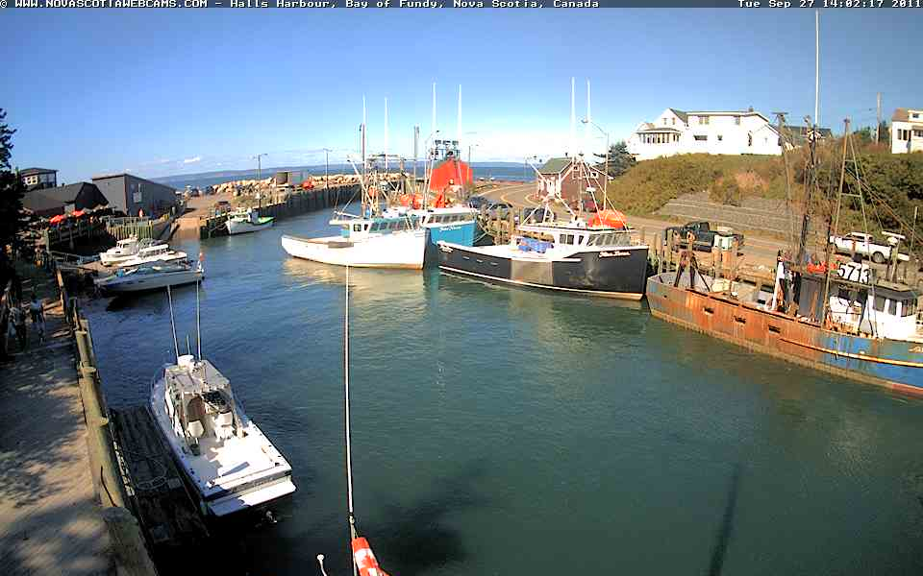
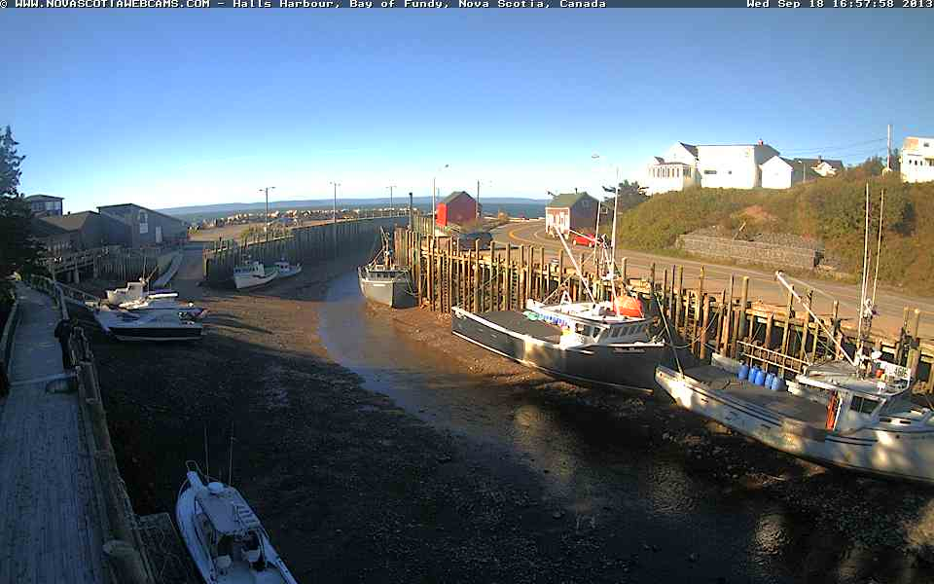
Notes:
http://www.novascotiawebcams.com/bay-of-fundy/halls-harbour-1.html

Slide 3
DAILY change in the water LEVEL of the ocean
High tide
Water @ its highest level
Low tide
Water @ its lowest level

Slide 4
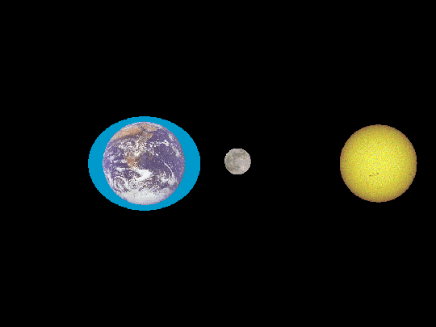
What CAUSES tides?
Gravitational force of the moon pulling on water
Side of the Earth closest to the moon feels the strongest pull
Creates a bulge of water on one side of the Earth
High tide

Slide 5
As moon orbits Earth, it pulls the bulge of water along
Why is there a bulge on the other side of Earth?
Moon also pulls on Earth
Water on other side is ‘left behind’
Forms a similar bulge

Slide 6
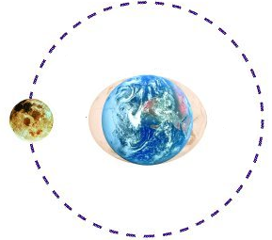
High tide is experienced when a location is in a bulge
Low tide is experienced when a location is not in a bulge

Slide 7
Types of Tides
When are tides (differences in water levels) the largest?
When are tides the smallest?

Slide 8
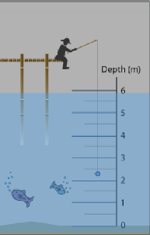
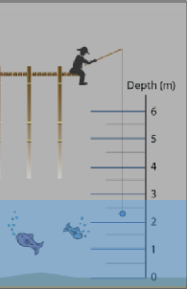
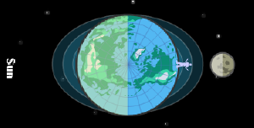
1) Spring tide
Occurs when the sun and moon are ALIGNED
Gravitational pull is COMBINED
LARGE difference between high and low tides
High tides are very high; low tides are very low

Slide 9
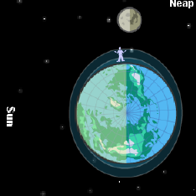
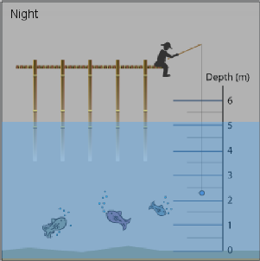
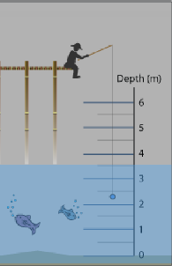
2. Neap tide
Occurs when sun and moon are perpendicular to each other
Gravitational pull is split
Smaller difference between high and low tide

Slide 10
Notes:
http://www.mreclipse.com/Special/LEprimer.html
http://science.opposingviews.com/tide-corresponds-solar-eclipse-3392.html

Slide 11
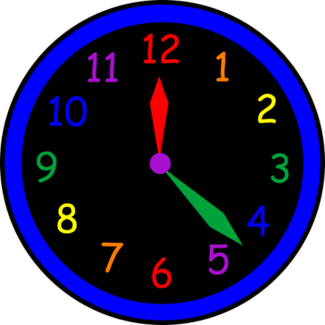
When do tides occur?
There are 2 low tides + 2 high tides every 24 hrs 50 min
Moon orbits Earth ~ 27 days
Pulls the large bulge of water along
Earth’s rotation - 24 hrs
Earth’s orbiting ~ 365 days

Slide 12
Effects of Tides
Cycles of erosion / deposition
Continuously changes shorelines
Creates a new ecosystem
Intertidal zone
Aquatic environment during high tide
Desiccated (dry) environment during low tide

