Slide 1
Cell Theory
Notes:
Grasslands
(Basic)
Note: This template is optimized for PowerPoint 2010 and uses a video background. If used in PowerPoint 2007, video elements will play, but all content will be covered by video background when in slideshow. If used in PowerPoint 2003, video will not play, but the poster frame of the videos will remain in place as a static image.
The video:
Plays automatically after each slide transition.
Is 30 seconds long.
Seamlessly loops for infinite playback.
To add slides or change layout, do the following:
To add a new slide, on the Home tab, in the Slides group, click the arrow under New Slide, then click under Motion Background Theme select the desired layout.
To change the layout of an existing slide, on the Home tab, in the Slides group, click Layout, then select the desired layout.
This template uses the “Pushpin” Theme Font. To access or change the Theme Font, do the following:
On the View tab in the Master Views group, select Slide Master.
In the Slide Master view, select slide 1 (the Master Slide for Master Layouts that use the video background).
On the Slide Master tab, in the Edit Theme group, click Fonts, and then select new theme fonts.
Using animated elements:
Any animated element will begin after the slide transition and the background video has started.

Slide 2
Spontaneous Generation
Recipe for Mice:
Life could emerge spontaneously from non-living matter

Slide 3
Francesco Redi (1668)

Slide 4
John Needham (1745)
Lazzaro Spallanzani
Drew off the air after boiling & plugged

Slide 5
Air was required for spontaneous generation?

Slide 6
Louis Pasteur (1864)
Tested the idea of microorganisms in the air
Concluded that life came from life

Slide 7
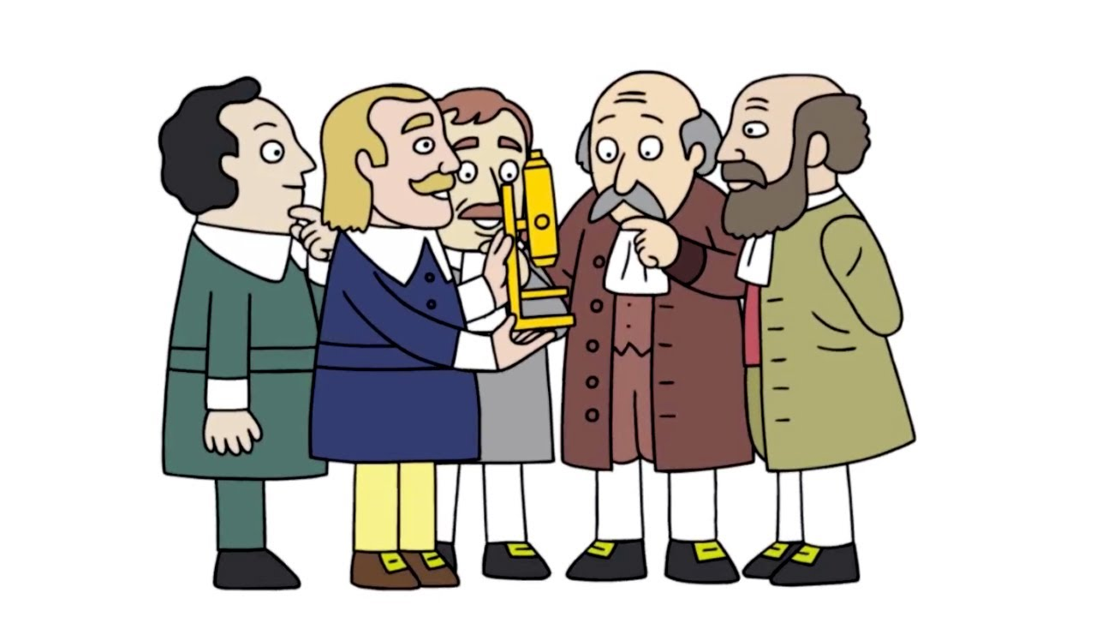
Cell Theory
Developed by Schleiden & Schwann
1. All living things are made up of one or more cells
2. All life functions take place in cells
Smallest unit of life
3. All cells are produced from pre-existing cells
Cell division

Slide 8
Cell Research

Slide 9
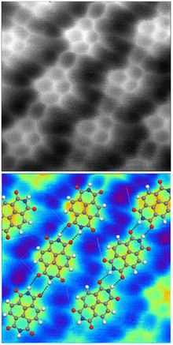
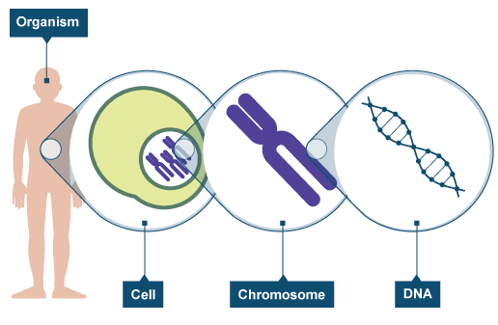
Atomic Force Microscope (AFM)
Produce images of molecules
Gene Mapping
Nucleus
Chromosomes
Genes
DNA
Sequence (map) genes

Slide 10
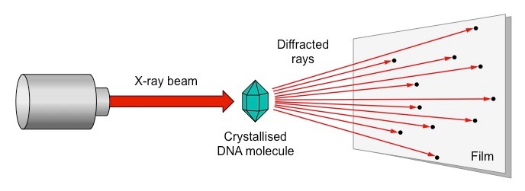
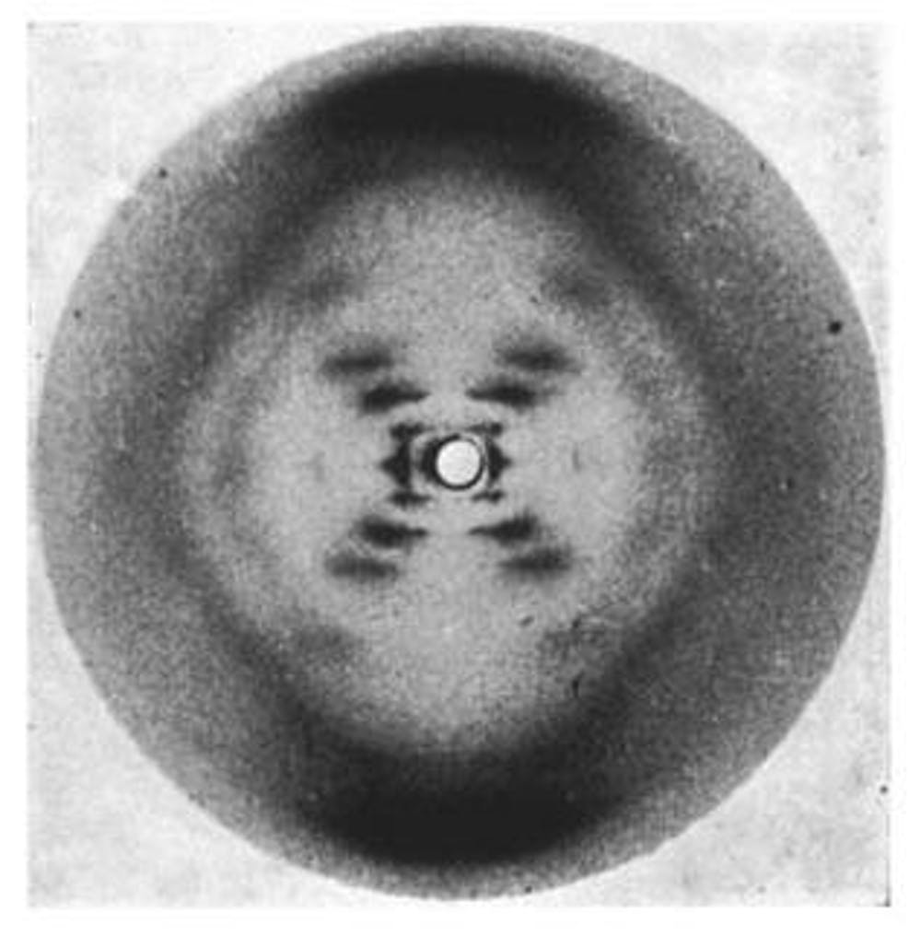
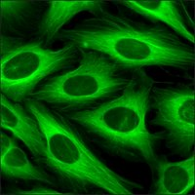
X-ray Crystallography
Details of molecular structure
Green Fluorescent Protein
Allows for the study of living cells

