Slide 1
Field of View Questions and Answers
If you have not submitted them, submit them now for a mark. Otherwise a mark of 0 will be assessed. If you need to talk to me for any reason about not being able to submit this, see me after class.

Slide 2
Cells Quiz Review
Section 1-5 Review Questions and Visuals

Slide 3
What are the 6 characteristics of living things?

Slide 4
What structures do humans have for each function of living?
Made of cells
Need energy
Grow and develop
Reproduction
Adaptations to the environment
Responding to the environment

Slide 5
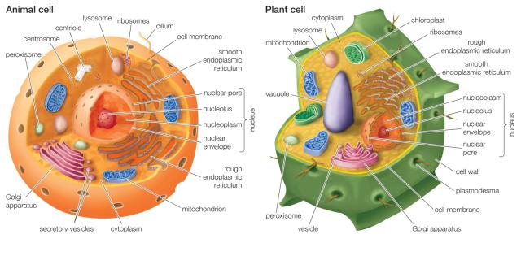
Cell Structure (Plant and Animal)

Slide 6
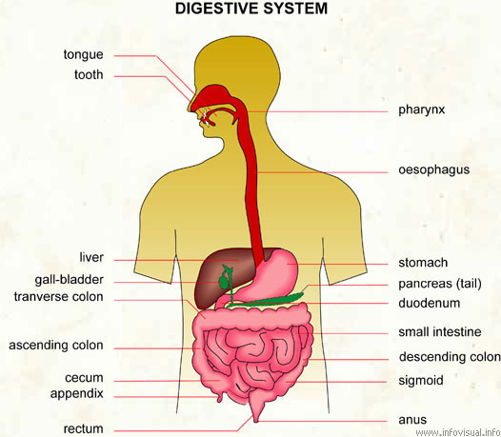
How Do Humans Get Energy?

Slide 7
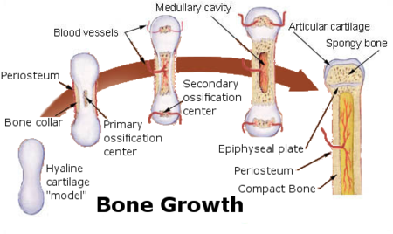
Humans Growing and Developing

Slide 8
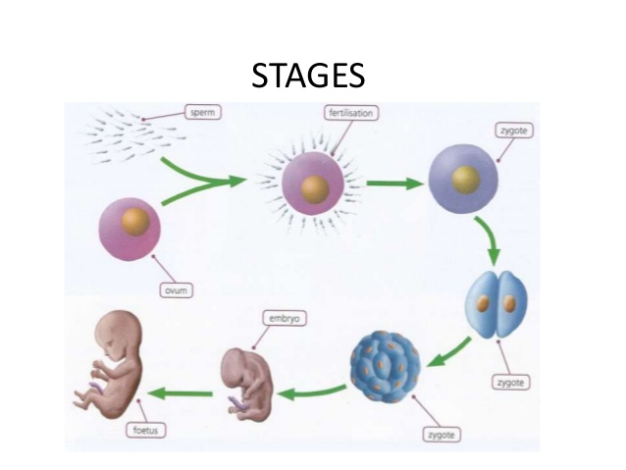
Human Stages of Reproduction

Slide 10
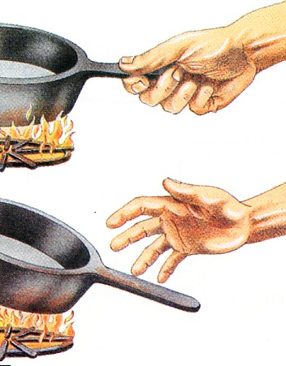
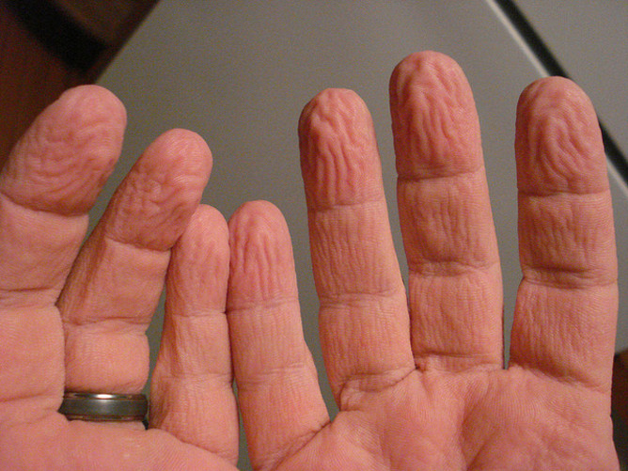
Responding to the Environment

Slide 11
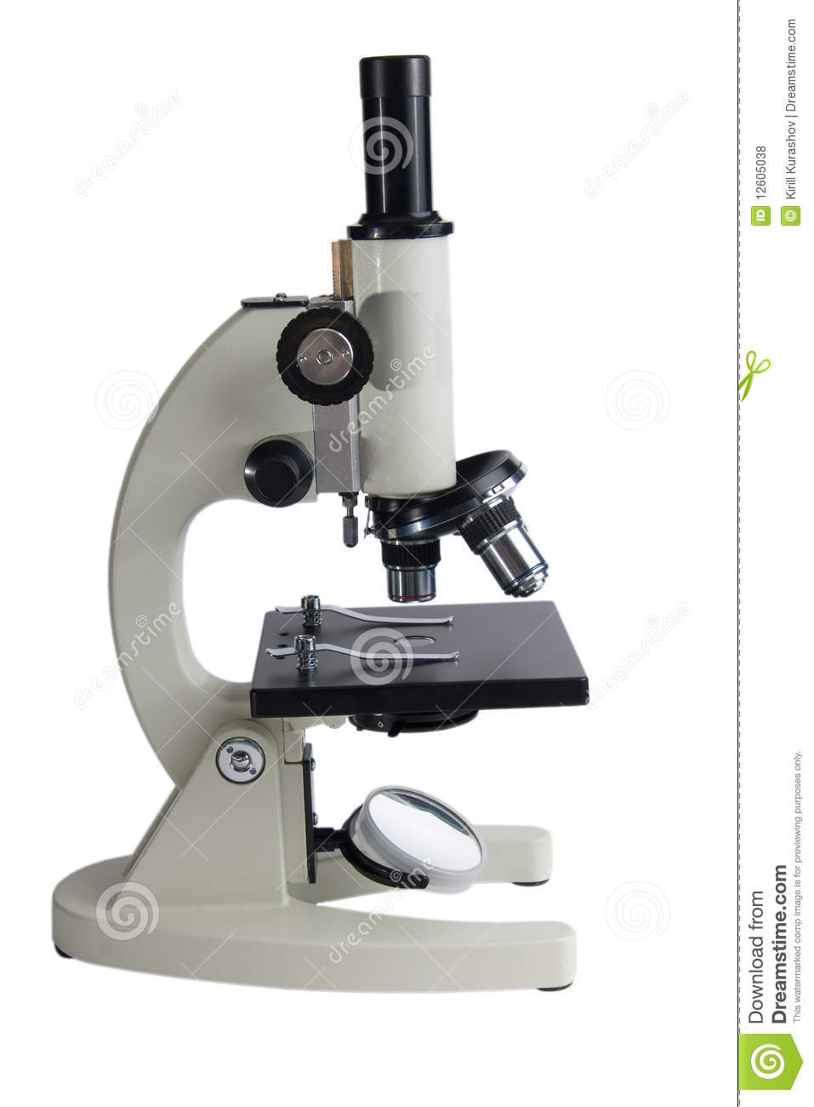
Structures and Functions of the Microscope

Slide 12
How do you prepare a slide? How do you focus the slide on the microscope? What are the total magnifications under the microscope? Can you estimate the size of a specimen under magnification?

Slide 13
What is the difference between unicellular and multicellular organisms?

Slide 14
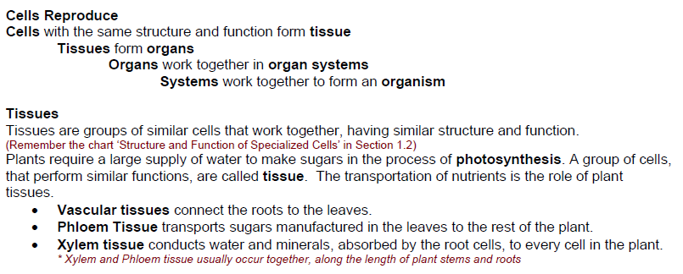

Slide 15
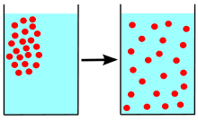
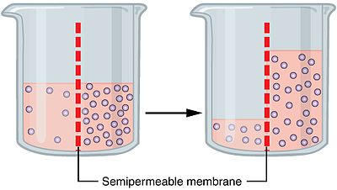
What is diffusion? What is osmosis?
Diffusion
Osmosis

