Slide 1
Crohn´s disease
by.Makenna marcucci 8m

Slide 2
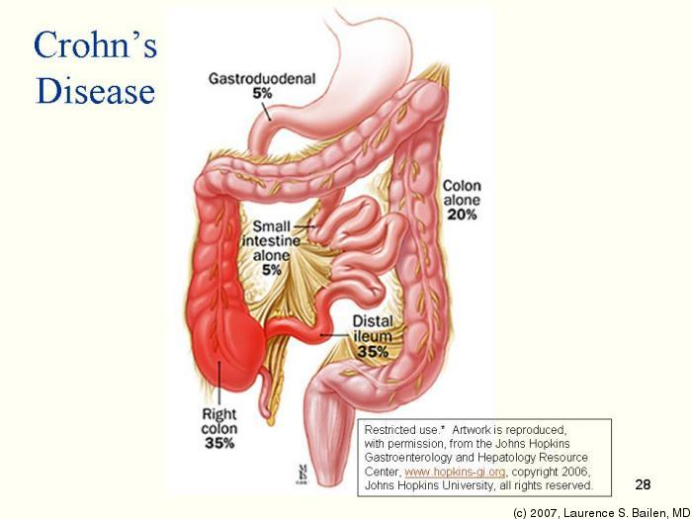
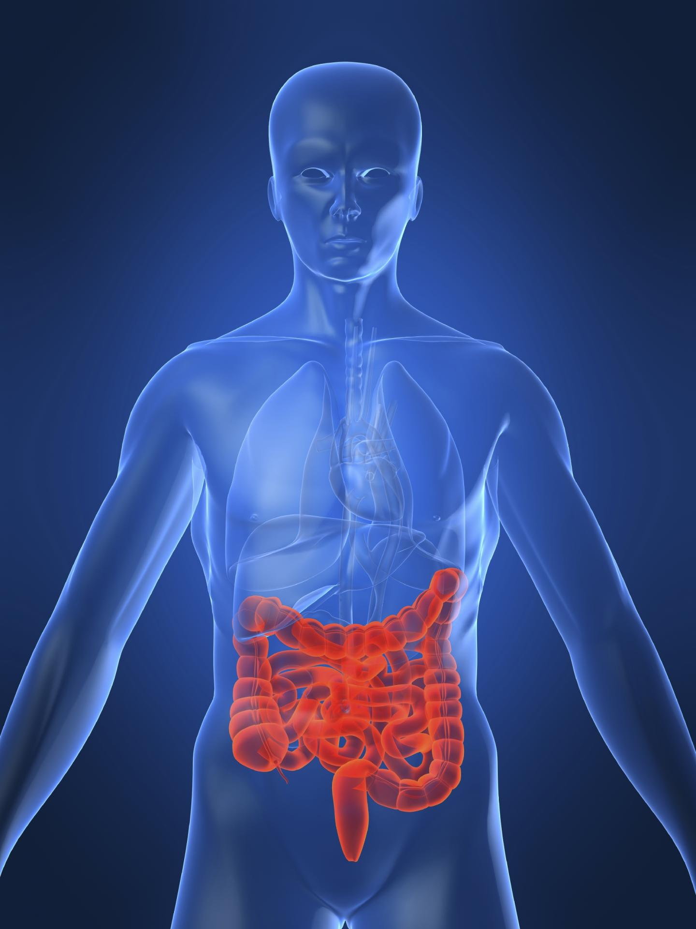
About Crohn´s
Crohn´s disease is an inflammatory bowel disease. It causes inflammation of your digestive tract, which can sometimes lead to abdominal pain,diarrhea, malnutrition,weight loss and fatigue.It can also lead to surgerys. Doctors are still not sure how it's caused.They said it might be due to abnormal response to the immune system or maybe the lining of the bowel.

Slide 3
Crohn’s
The symptoms of Crohn’s are belly pain,diarrhea,loss of appetite,fever,and weight loss. The treatment of Crohn's is medicine to stop the inflammation in the intestine.You can never get rid of Crohn's it is a lifelong illness. Crohn's can not affect everyone. Doctors still don't know how it's caused or how people get it but it is not contagious.

Slide 4
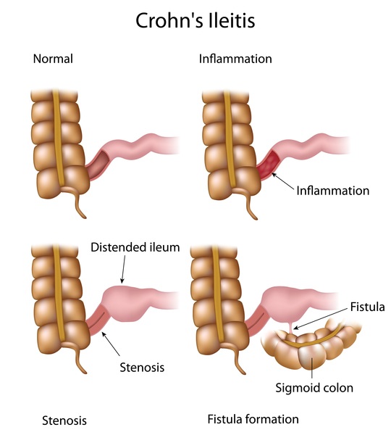
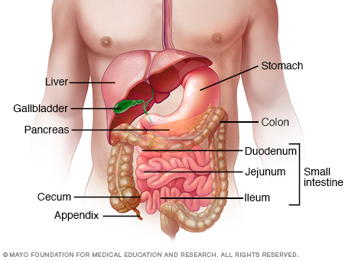
Affect
Crohn’s disease affects any part of the gastrointestinal tract. The organs it affects is the small bowel (the ileum),and the beginning of the colon and the intestine. Crohn's is not a autoimmune disease and the immune system is not triggered.

Slide 5
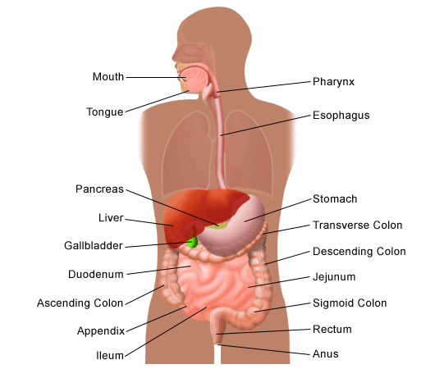
Function
As again Crohn's affects the bowels and gastronomical tract. The bowel helps your body by digesting your food and letting it go thru a tube and get rid of waste. And the gastronomical tract helps to digest. Crohn's affects the liver,pancreas,bowel,gallbladder and digestive tract.

Slide 6
Gluten allergies similar symptoms
If you're allergic to gluten the side effects are mostly the same to the side effects of maybe having crohn's.The symptoms of being allergic to gluten is digestif issues ,keratosis pilaris on back of your arms or acne on skin.

Slide 7
Sources
https://www.webmd.com/ibd-crohns-disease/crohns-disease/.../crohns-disease-symptoms
-https://www.webmd.com/ibd-crohns-disease/crohns.../crohns-disease-treatment-overview
www.crohnscolitisfoundation.org/assets/pdfs/living-with-crohns-disease.pdf
https://www.everydayhealth.com/crohns-disease/...crohns.../what-is-crohns-disease.aspx
https://www.webmd.com/ibd-crohns-disease/crohns-disease/.../crohns-disease-symptoms
ccfa.org/what-are-crohns-and-colitis/what-is-crohns-disease/
https://www.healthline.com/health/crohns-disease

Slide 8
Rupric
Describe the disorder or disease:
Slide 1:Title of disease/disorder /1
Slide 2:
What is it? /3
How is it caused? /2
Picture of disease/disorder /3
Slide 3:
What are the symptoms? /2
What is the treatment? /2
Can it affect everyone? /2
Slide 4:
Which system does it affect? /1
Which organs in the system does it affect? /1
Does it affect more than just the system you chose (eg: lung cancer affects the respiratory system but can also affect the circulatory system) /2
Slide 5
Describe the function of the affected body system (from slide 4) /3
List the organs involved with this system /2
Picture of the body system /2
Slide 6:
Sources /2
Creativity of slides /2
OUT OF 30

