Slide 1
W/ Rei and Nolan

Slide 2
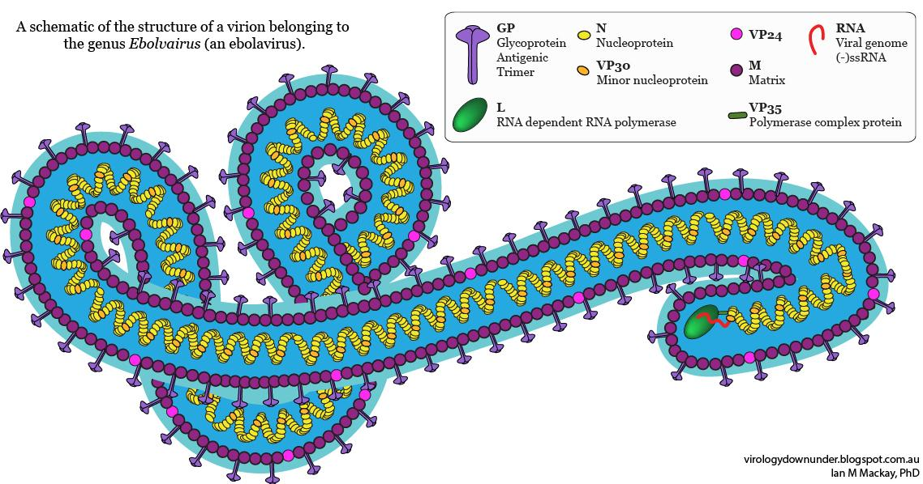
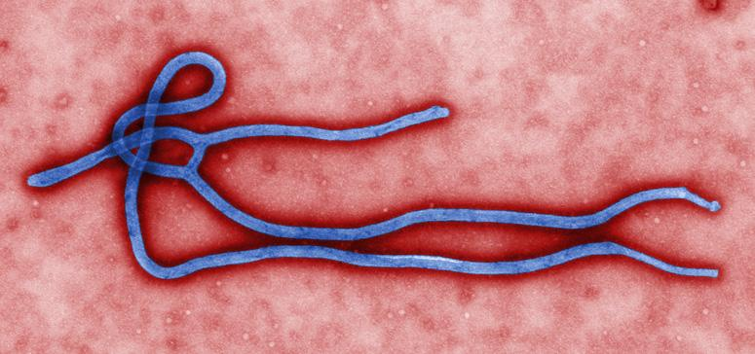
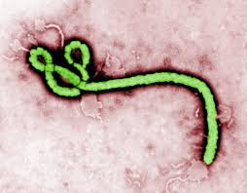
What is it? How is it caused?
Ebola is a very rare, yet devastating disease. It was discovered in 1976 and kills around 70% of infected people. It is thought that fruit bats are natural ebola virus hosts. It can be spread through close contact with blood, organs or other body fluids from animals found ill or dead in the rainforest.

Slide 3
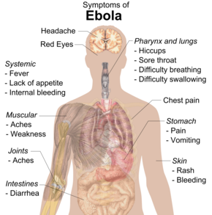
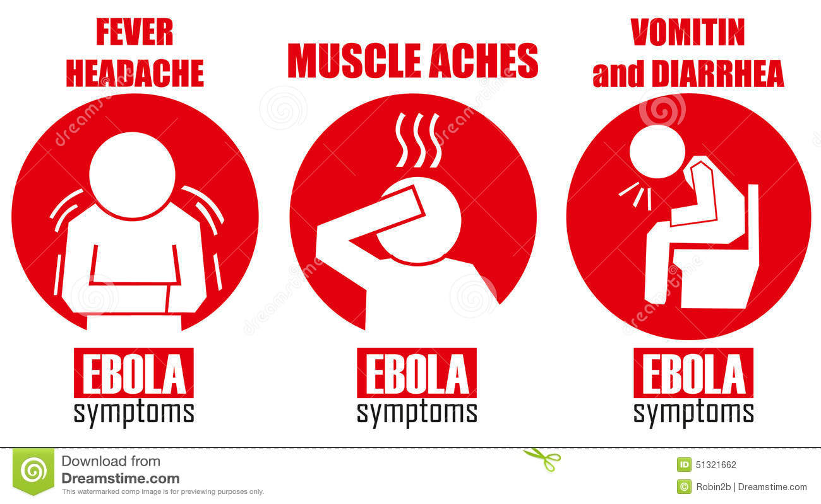
What are the symptoms? What is the treatment? Can it affect everyone?
It’s symptoms are fever, severe headache, muscle pain, weakness, fatigue, diarrhea, vomiting and stomach pain. In December 2016, a study found the VSV-EBOV vaccine to be 95-100% effective against the Ebola virus. It was the first proven vaccine against the disease. It can affect everyone because it is a disease and diseases can spread.

Slide 4
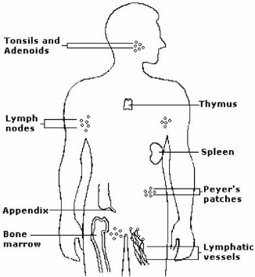
Which system does it affect? Which organs in the system does it affect? Does it affect more than just the system we chose?
The ebola virus affects the immune system. The organs that are affected in the immune system are the ones shown in the image.
Of what we found, ebola also affects the respiratory system as well because it causes people to cough, have sore throat ,difficulty of swallowing and hiccups.

Slide 5
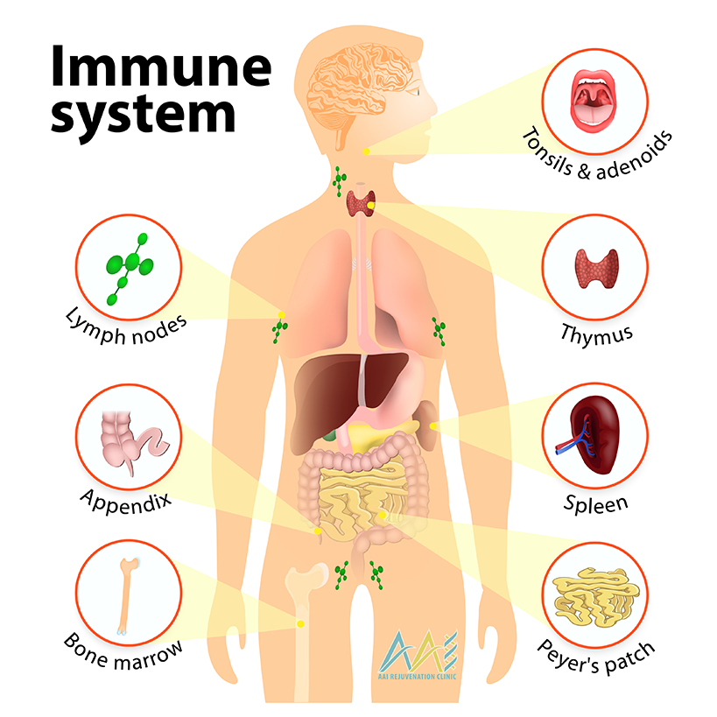
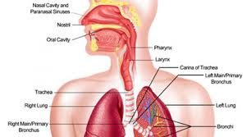
Describing the affected Body systems
Respiratory
The respiratory system is the system that allows you to breath. It transports oxygen from the air to your blood. The organs in the respiratory system are the nose , mouth, trachea, diaphragm, bronchi and the lungs.
Immune
The immune system is the system that allows your body to fight off diseases, illnesses and viruses. The organs in the immune system are the lymph nodes, appendix, bone marrow, tonsils and the spleen.

Slide 6
http://www.who.int/mediacentre/factsheets/fs103/en/
https://www.webmd.com/a-to-z-guides/ebola-fever-virus-infection

Slide 8
Choose one disorder, disease or medical condition that could happen in one of the body systems: (digestive, circulatory, respiratory, excretory, skeletal, muscular or nervous). You can present the information in format of choice: poster, google slides
Describe the disorder or disease:
Slide 1:Title of disease/disorder 1/1
Slide 2:
What is it? 3/3
How is it caused? 2/2
Picture of disease/disorder 3/3
Slide 3:
What are the symptoms? 2 /2
What is the treatment? 2/2
Can it affect everyone? 2/2
Slide 4:
Which system does it affect? 1/1
Which organs in the system does it affect? 1/1
Does it affect more than just the system you chose (eg: lung cancer affects the respiratory system but can also affect the circulatory system) 2 /2
Slide 5
Describe the function of the affected body system (from slide 4) 3/3
List the organs involved with this system 2/2
Picture of the body system /2
Slide 6:
Sources 2/2
Creativity of slides 3/2
OUT OF 30
1

