Slide 1
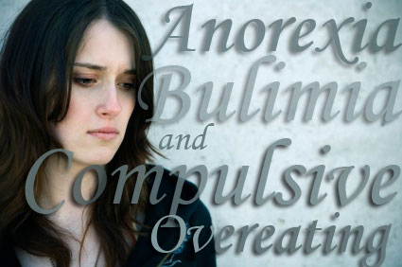
Eating Disorders
By:Emily.R. and Ashley

Slide 2
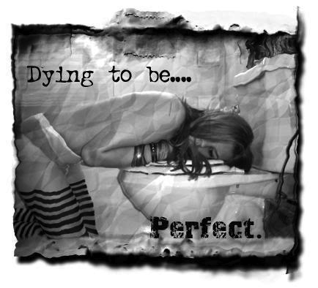
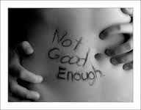
Bulimia
What is it?
Bulimia is a eating disorder where you eat a lot and then throw up a bulimic usually eats all the regular meals a you do but bigger and usually throws up at least 3 times a day or more but not always after every meal.
Effects that can kill you
Tearing of the esophagus results in blood in your vomit.
Dehydration results in when you throw up you lose fluids this can result in kidney failure, heart failure, seizures, brain damage, and even Death.
Digestive Problems is caused because your stomach is use to you throwing up.
Acid Reflux results in the valve that controls your stomach acid becomes faulty and can cause Barrett's Esophagus that can lead to CANCER.
Constipation this is where your stomach can’t digest food properly so food gets get digested slower.

Slide 3
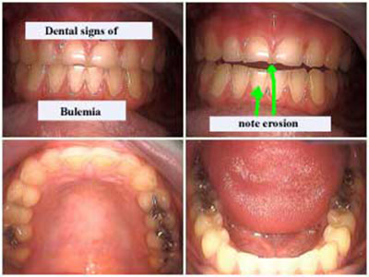
Anemia the result of this is drowsiness, lose or short of breath, infections and heart problems. As well you will be pale and get gray bags under and around your eyes
Pancreatitis this results in digestive enzymes attacking the pancreas and is life threating and results in Death.
Hypo and Hyperglycemia this is when your blood sugar levels are way too low and there is a lot of glucose in your blood plasma.
Liver Failure which can and will result in death.
Bone Density Problems this is the most common irreversible result of bulimics.
Infertility and bulimia Pregnancy problems being bulimic can effect your ability to have children.
Kidney Infection and Failure after binging and purging for long periods of time it may result in your kidneys to stop functioning and your toxins slowly poison you.
10 In100 TEEN GIRLS have
EATING DISORDERS this occurs in boys
as well but less often

Slide 4
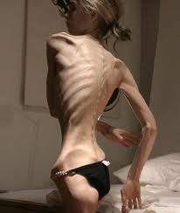
Anorexia what is it?
Anorexia is an eating disorder where people are obsessed with there weight and the food they put in there body. People who are anorexic try and stay at a weight that is not even close to a normal healthy weight for there height and age. To try and prevent gaining weight and continue losing there weight people who are anorexic tend to starve them selves and or exercise excessively. This eating disorder is not technically not all about the food but an unhealthy way to deal with emotional problems. This results in you judging your self not on how you feel about your self but how thin you are. This is difficult to overcome but after and with extensive care and treatment you may be able to find your self and get better eating habits that can also possibly in some cases change anorexic complications.
Anorexia in girls 9 and under have doubled in the past year around 90,000 Britons are being treated with eating disorders and girls 14-24 are at greater risk.

Slide 5
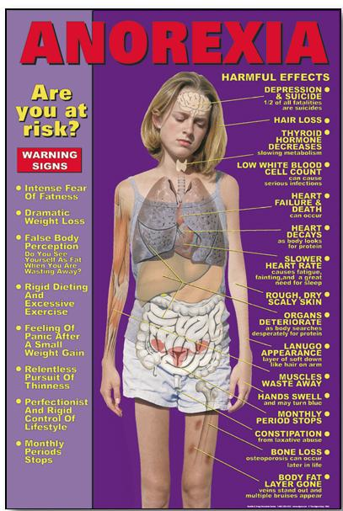
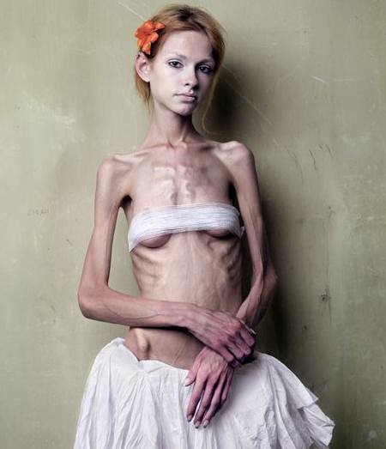
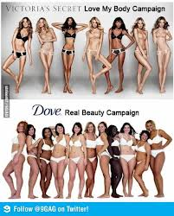
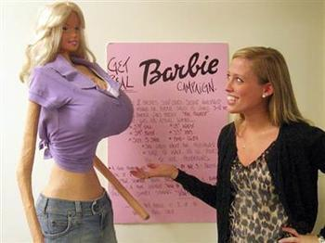
Effects and pics

Slide 6
Videos!!!
http://www.youtube.com/watch?v=hibyAJOSW8U
http://www.youtube.com/watch?v=sz-nPMTXduo&safety_mode=true&persist_safety_mode=1&safe=active

Slide 7
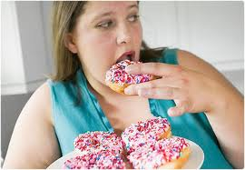
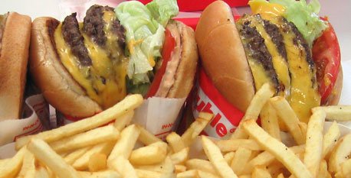
Compulsive overeating disorder
What is it?
It is where you eat uncontrollably and or frequently and have binging episodes. When you bing eat you may feel like you aren’t in control. They eat really fast and even though they are uncomfortably full they will just continue eating. After they will feel guilty and depressed. The difference between bulimics and compulsive overeaters is overeats wont purge ,use laxatives ,throw up ,or fast as a result of there guilt. Even when they are not hungry they will still eat. Food takes there mind off things so they typically eat alone. This often leads to obesity and weight gain. Its important to note that not all obese people are overeaters. Compulsive overeating people my start grazing behavior this is where you constantly pick up food over and over again. And even though they may eat a lot but tiny servings it still adds up to be the same amount of fat and calories as if you eat it all at the same time.

Slide 8
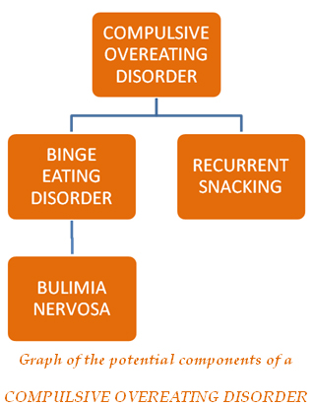
Effects
Fear of eating habits
Afraid of eating with others
Attempts at diets
Dreaming of a better life
Hiding food
Not really any eating patterns
Uses weight as an excuse
food is there only friend
out of shape
Lose of breath and out of shape
Sweats a lot more
cholesterol and high blood pressure problems
joint and leg pain
excessive weight gain
Loss of mobility
Fast mood changes
Weird sleep patterns

Slide 9
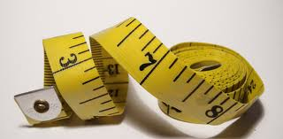
Thank you for watching
Remember you have so much to live for.
Lots of people love you
And make good choices [most of the time ;) ]
You the best Mrs. Bohaychuck
By: Emily and Ashley 8S

Slide 10
Web Sites
video-
http://www.your-bulimia-recovery.com/bulimia-complications.html
http://www.mayoclinic.com/health/http://
www.eatingdisordertreatment.net/eating-disorder-treatment/compulsive-eating-information-symptoms-and-treatment-of-compulsive-overeatinganorexia/DS00606
You tube
Google
Unbearable lightness

